Slide 1
WEST VIRGINIA DEPARTMENT OF EDUCATION INITIATIVES 2017-18
Lee Ann Brammer, Coordinator

Slide 2
FINANCIAL DISCLOSURE
Ms. Brammer is employed by the West Virginia Department of Education.
There are no other relevant financial or nonfinancial relationships to disclose.

Slide 3
LEARNER OUTCOMES
Participants will become familiar with at least three initiatives of the West Virginia Department of Education.
Participants will receive information from the Professional Development for Speech Therapists Survey.
Participants will become familiar with at least three initiatives directly related to speech-language pathologists.

Slide 4
THANK YOU
To the WVSHA Executive Board, including Rhea Dyer and Vickie Pullins, as well as Helan Turner for allowing us to have three spring meetings sponsored by the West Virginia Department of Education as a part of the West Virginia Speech-Language and Hearing Association Conference and for assisting us with ASHA CEUs.
Your collaboration is very much appreciated!

Slide 5
WVDE MISSION

Slide 6
WE HAVE A NEW WEBSITE DESIGN (Still a work in progress)

Slide 7
OFFICE OF SPECIAL EDUCATION

Slide 8
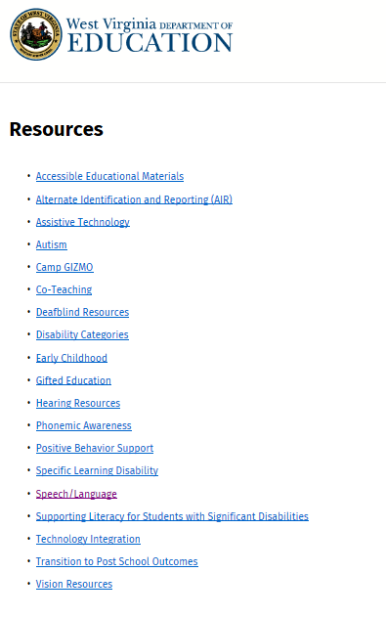
SPEECH-LANGUAGE IMPAIRED
Located under Resources

Slide 9
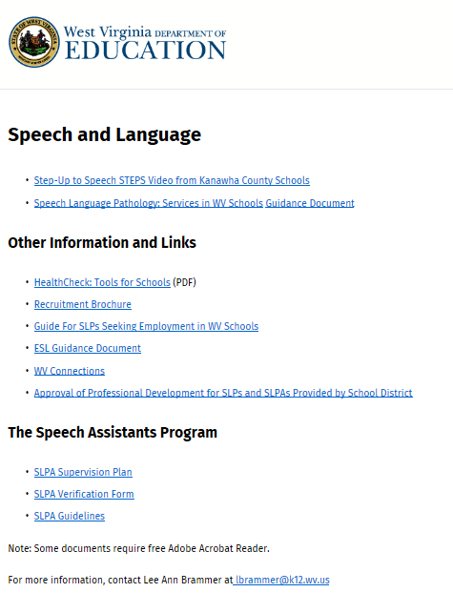
SPEECH-LANGUAGE IMPAIRMENT
http://wvde.state.wv.us/osp/speechlanguage.html
All of these documents are in the process of being updated

Slide 10
SPEECH-LANGUAGE IMPAIRMENT
https://wvde.us/special-education/resources-sp-page/speech-language-impairment/
Eventually will have future trainings/online courses listed under “Professional Learning”

Slide 11
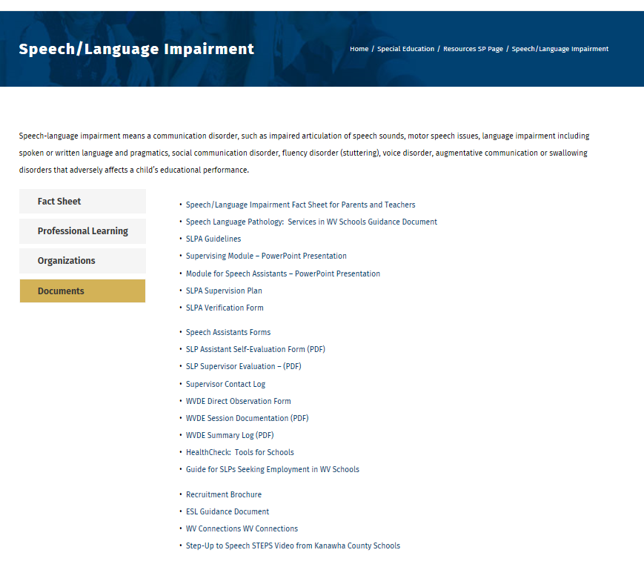
DOCUMENTS
https://wvde.us/special-education/resources-sp-page/speech-language-impairment/
All documents in the process of being updated

Slide 12
NEW OFFICE OF SPECIAL EDUCATION FOCUS
Looking at improving reading and math skills
Hiring two new coordinators (reading and math)

Slide 13
WVDE NEW ASSESSMENTS
Grades 3-8 West Virginia Summative Assessment
High School SAT School Day
Alternate Assessment West Virginia Alternate Summative Assessment – Dynamic Learning Maps
Interim Assessments Given to 3-8 graders to allow teachers to assess student progress throughout the year and support instruction for the standards

Slide 14
COLLEGE- AND CAREER- READINESS STANDARDS

Slide 15
INITIATIVES WITHIN THE OFFICE OF SPECIAL EDUCATION
Project Aware
Graduation 20/20
ECPBIS
All Things Alternate
PECS Level 1 Training
Celebrating Connections
Camp Gizmo
Functional Listening Evaluation Training
Functional Vision Evaluation Training
Can We Talk?

Slide 16
PROJECT AWARE
Project AWARE’s purpose is to increase awareness of the mental health issues throughout the state by training school personnel and other adults who interact with school-aged youth on how to detect, respond and connect children and families who may have mental health issues with the appropriate services.

Slide 17
GRADUATION 20/20
Graduation rates for students with disabilities have risen from
59.9% to 75.7% in the five years of the initiative.
As a result of Grad 20/20, graduation rates of all students have
increased.

Slide 18
WV GRADUATION 20/20 GOALS
To improve student literacy and numeracy achievement
Increase the number of students who graduate with a regular diploma
Decrease number of number of students who drop out
Increase attainment of better post-secondary outcomes

Slide 19
Hancock
Hancock
WV GRADUATION 20/20 Participating Counties
SY 2017-2018
Brooke
Ohio
Marshall
Wetzel
Monongalia
Morgan
Pleas-
Tyler
Marion
Berkeley
ants
Preston
Mineral
Jeff-
Dodd-
Harrison
Taylor
Hampshire
erson
Wood
Ritchie
ridge
Barbour
Grant
Wirt
Lewis
Tucker
Hardy
Jackson
Cal-
Gilmer
houn
Upshur
Randolph
Mason
Roane
Braxton
Pendleton
Cabell
Putnam
Clay
Webster
Kanawha
Nicholas
Pocahontas
Wayne
Lincoln
Boone
Fayette
Greenbrier
Mingo
Logan
Raleigh
Wyoming
Sum-
mers
Monroe
McDowell
Mercer
Notes:
We started out with a pilot of 5 counties – Mason, Cabell, Wayne, Mingo, and Logan. The success’ and barriers experienced by the Pilot counties drove the changes we made for the implementation of our initiative. We conducted a focus group with the pilot counties. That information along with other lessons learned helped us develop our GRADUATION 20/20 Implementation Manual.

Slide 20
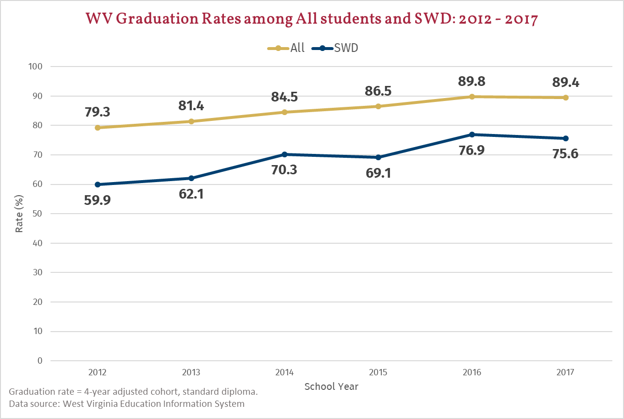

Slide 21
WEST VIRGINIA ECPBIS
Amy Carlson, Ed.D. CCC-SLP
ECPBIS Coordinator
WV Autism Training center at Marshall university

Slide 22
WHAT IS ECPBIS, OR, THE PYRAMID MODEL?
Early Childhood Positive Behavioral Interventions and Supports
aka The Pyramid Model

Slide 23
PURPOSE OF ECPBIS…
Promote social and emotional development in all children including those with special needs

Slide 24
KEY FEATURES OF ECPBIS
Children’s challenging behavior can be reduced with support not punishment
Promoting social emotional development is not easy. There are no quick fixes to challenging behavior.
Focus on prevention and teaching appropriate skills. If you want it, TEACH it!
The Pyramid Model *Key Feature* = The balance between acknowledgment and correction

Slide 25
CONTACT INFORMATION
Amy Carlson, Ed.D. CCC-SLP
ECPBIS Coordinator
WV Autism Training Center at Marshall University
amy.carlson@marshall.edu

Slide 26
ALL THINGS ALTERNATE
Alternate Standards
Alternate Assessment
Alternate Diploma
Dawn Embrey-King, Coordinator

Slide 27
DISTRICT OBLIGATIONS PER ESSA REQUIREMENTS
Replaced modified diploma with State-Defined Alternate Diploma which requires:
Instruction in alternate academic achievement standards linked to general standards;
Participation in alternate assessment;
Alignment with state requirements for the regular high school diploma; and
Be obtained during FAPE period.
Students receiving an alternate diploma will be included in the graduation cohort for the year in which they graduate. Incoming ninth grade students should be considered for the alternate diploma. (pp. 9, 117)
Notes:
This slide was also in the 2419 webinar. It says that we are changing the wording from modified diploma to alternate diploma.
This slide also gives our state’s criteria for a state defined alternate diploma
(read bullets)
It’s important to note that this year’s 9th grade cohort (incoming 9th graders) may be considered for the alternate diploma if the criteria is met.
On another slide we will be addressing the Alternate Standards and Alternate Diploma Timeline so you will see when everything will go into effect.

Slide 28
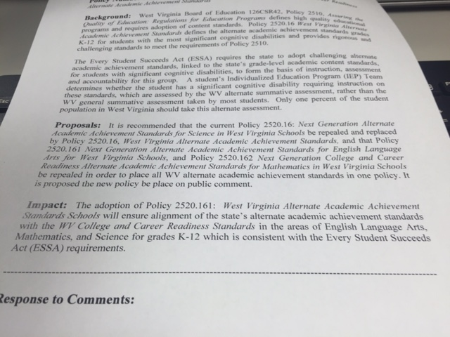
POLICY 2520.16
West Virginia Alternate Academic Achievement Standards
Notes:
So here is the new policy. Policy 2520.16
This is a screen shot of the first page of the policy which is currently going through the proper channels of editing by the legal department in preparation for board approval in August.
In the proposal section (which I know you can not read), it says that the previous three separate policies Next Generation ELA, math and science alternate standards will all be combined into one policy which again is policy 2520.16 WV Alternate Academic Achievement Standards.

Slide 29
ALTERNATE STANDARDS, ASSESSMENT AND DIPLOMA TIMELINES
Year | 2017-2018 | 2018-2019 | 2019-2020 | 2020-2021
Diploma Type | Modified Diploma | Modified Diploma | Modified Diploma | Alternate Diploma
Alternate Standards | (Current Standards) Alternate Standards (ELA, math, science) 9th grade cohort | (New Standards) Alternate Academic Achievement Standards 2520.16 9th and 10th graders | (New Standards) Alternate Academic Achievement Standards 2520.16 9th 10th and 11th graders | (New Standards) Alternate Academic Achievement Standards 2520.16 9th 10th 11th and 12th
Alternate Assessment | Current Alternate Summative Assessment | Current Alternate Summative Assessment | Current Alternate Summative Assessment | New Alternate Summative Assessment

Slide 30
Strategies for meeting the 1% participation cap
Gather district and school data on current participation rates in the alternate assessment.
Gather data on the characteristics of students participating in the alternate assessment.
Create or examine a state definition of “students with the most significant cognitive disabilities” and revise guidelines, as needed, for determining whether a student should participate in the alternate assessment.
Provide PD for IEP team members and other educators on alternate assessment and who should participate in it.
Provide information sessions for parents of students with disabilities so that they can participate in the IEP decision-making process about the assessment in which their child participates.
Notes:
Here are the 5 strategies again. I repeated this slide so we could take another look and see which things we are already doing in our state.
Believe me as we talk to the federal govt and other states, we realize that again WV is leading this charge around the alternate standards, alternate assessment and alternate diploma.

Slide 31
PICTURE EXCHANGE COMMUNICATION SYSTEM (PECS) Level 1

Slide 32
CELEBRATING CONNECTIONS

Slide 33
COME AND SEE US!
Libby Simmons and Lee Ann Brammer – Session C-2
“I Have Something to Say!” - Speech-Language Pathologists and Preschool Teachers Working Together to Give All Children Opportunities to Communicate”
Wednesday, April 11, 2018 1:00-4:00 pm

Slide 34
CAMP GIZMO
Please be sure to refer children from birth to 8 who have multiple disabilities
July 7-11, 2018
Camp Gizmo is funded by the WV Dept of Ed/Office of Special Programs,
WVDHHR/Bureau for Public Health/Office of Maternal, Child and Family
Health/WV Birth to Three and WVDHHR/Bureau for Children and Families/Division
of Early Care and Education and in-kind support is provided by WVATS, WVU Center of
Excellence in Disabilities, National Seating and Mobility and Assistive Technology Works, Inc.
Support and coordination provided by WV Early Childhood Training Connections and Resources.
http://www.wvearlychildhood.org/Camp_Gizmo.html

Slide 35
FUNCTIONAL LISTENING EVALUTION TRAINING (FLE)
Jointly sponsored by Wendy Garrison, Coordinator, Low Incidence and Lee Ann Brammer, Coordinator, Speech-Language Impairment
Training provided by Molly Simonton, Adjunct Faculty, Marshall University
Five trainings - Parkersburg (2), Morgantown, Beckley and Charleston
Speech-language pathologist (50) and teachers of the deaf/hard of hearing trained (19) as well as 11 in other positions trained

Slide 36
FUNCTIONAL VISION ASSESSMENT TRAINING (FVA)
Jointly sponsored by Wendy Garrison, Coordinator, Low Incidence and Lee Ann Brammer, Coordinator, Speech-Language Impairment
Training provided by Becky Coakley, Director of Outreach, WVU Eye Institute
Two trainings – Morgantown and Beckley
Forty-four teachers of the visually impaired trained

Slide 37
CAN WE TALK? TRAINING
Jointly sponsored by Ruth Ann King, Coordinator, Deaf/Blind Project and Lee Ann Brammer, Coordinator, Speech-Language Impaired
For service providers who serve children with multiple disabilities
Training provided by Nancy Steele, former project specialist, National Center on Deaf/Blindness
Training provided in Bridgeport and Beckley
Follow-up technical assistance in counties

Slide 38
WEST VIRGINIA SUMMIT FOR EDUCATIONAL EXCELLENCE – SESSION TWO Office of Special Education
Morgantown (Lakeview Resort) – July 19-20, 2018 – 8:00-4:00
Charleston – (Civic Center) August 2-3, 2018 – 8:00-4:00
Same breakout sessions at each location
Sessions will include co-teaching, online IEP, scheduling options for speech therapy, service delivery options for speech therapy, AAC and language sample transcription
ASHA CEUs will be provided
More information to follow
Taking the place of speech therapist participation in the KidStrong Conference

Slide 39
SPEECH-LANGUAGE IMPAIRMENT

Slide 40
FOCUS FOR THE COMING YEAR
Train SLPs statewide and provide resources to will prepare them to do comprehensive language evaluations, which will result in standards-based, educationally relevant IEPs
Provide training on different service delivery and scheduling models
Prepare materials to train parents, teachers, principals and special education directors on the new roles of SLPs and the students who will be identified as having a disability
Plan professional development activities which meet the identified needs of school speech-language pathologists
Develop a resource list for special education directors for services provided by universities across the state
Develop a plan for professional activities for the upcoming school year
Develop a cooperative to advertise jobs at the universities, as well as the WVSHA and WVDE websites

Slide 41
SPEECH-LANGUAGE IMPAIRMENT INITIATIVES
Policy 5202
Professional Development Committee
Professional Development Survey – February 2018
AT Boot Camp
Distance AT Evaluation Support
University of Cincinnati Distance Learning Cohort
New Speech Therapist Boot Camp
Lead Speech-Language Pathologist Meetings
Educationally Relevant Therapy
Comprehensive Language Evaluations
West Virginia Schools Feeding and Swallowing Protocol/Guidance
Communication Matrix Module Project
Updating all documents on the Speech-Language Impairment website including both guidance documents

Slide 42
POLICY 5202 – ALTERNATE PATH
Effective December 11, 2017
See explanation for application in packet
Joint effort – WVSHA, WVBESLPA and WVDE
Robert Hagerman and Pat Homberg, Executive Directors, WVDE
Rhea Dyer, WVSHA, President
Vickie Pullins, WV Board of Examiners, Secretary
Lee Ann Brammer, WVDE, Coordinator

Slide 43
POLICY 5202 STATES
10.4.d.1.a. Praxis Exam. -- Applicants who hold valid national certification by ASHA who took the Praxis exam required by ASHA at the time the national certification was obtained are exempt from meeting the Praxis requirement effective in the West Virginia Licensure Testing Directory at the time of application.

Slide 44
APPLICATION INFORMATION
See Licensure Information Chart in your folder
Forms located at https://wvde.us/certification-and-professional-preparation/certIfication/
For more information contact:
Brad Fittro, Coordinator, Office of Certification and Professional Preparation – 304.558.7010
Lee Ann Brammer, Coordinator, Office of Special Education – 304.558.2696

Slide 45
PROFESSIONAL DEVELOPMENT COMMITTEE
Invited professors from West Virginia University, Marshall University, University of Cincinnati and West Liberty University
Selected 12 lead speech-language pathologists from cross the state
Representatives from WVSHA – President Rhea Dyer and Conference Chair Vickie Pullins
Discussed the results of the WVDE and Marshall University surveys and planned professional development activities for the coming school year

Slide 46
PROFESSIONAL DEVELOPMENT COMMITTEE
University Representatives
Dr. Jayne Brandel, WVU
Dr. Karen McNealy, Marshall
Dr. Stephanie Bradley, West Liberty
Karen Haines, WVU
Mary Ellen Tekieli Koay, WVU
Cheryl Prichard, WVU
Mary Weidner, Marshall
Pam Holland, Marshall
Kelly Rutherford, Marshall
Tori Gilbert, West Liberty
WVDE Representatives
Lee Ann Brammer, Coordinator,
Jane Slijepcevic, Part-Time
Libby Simmons, Part-Time
School-Based Lead SLP Representatives
Heather Waselchalk, Kanawha
Michelle Hendrick, Cabell
Rhea Dyer, WVSHA President
Karen Underwood, Fayette
Kim Porter, Putnam designee
Vickie Pullins, WVSHA Conference Chair
Melanie Nixon, Brooke
Melanie Place, Berkeley
Tricia Hays, Brooke
Carol Zombotti, Wetzel
Tondra Elkins, Mingo
Leigh Smitley, Monongalia
Marsha Fink, Raleigh

Slide 47
PROFESSIONAL DEVELOPMENT COMMITTEE PURPOSE
Mission
“The mission of the Professional Development Committee is to develop a statewide plan to address the educational needs of SLPs working in the schools and adjust university curriculums to prepare students for the changing roles of SLPs.”

Slide 48
PROFESSIONAL DEVELOPMENT COMMITTEE GROUP GOALS
Streamline communication between schools and the universities
Identify ways to collaborate
How to better identify resources
To identify how universities can better serve the school-based SLPs and their professional development needs
Address literacy as it relates to our profession
Address feeding and swallowing in the schools
Enhance interprofessional collaboration and team approach for serving students
Develop professional development for administrators to understand the scope of practice of speech-language pathologists in the schools (top down approach)
Develop professional development on supervision of students
Develop an overall strategic plan with short-term and long-term goals
Develop a potential speaker list or professional development
Develop a university compilation of contact info and specialties

Slide 49
WVDE SPEECH-LANGUAGE PATHOOGY PROFESSIONAL DEVELOPMENT NEEDS SURVEY RESULTS
Date of survey – February 2018
Number of participants – 212
Raw results in your packet

Slide 50
HIGHEST DEGREE ATTAINED

Slide 51
TOPICS (Descending Order – Everything Above 3.0 Reported)

Slide 52
SUGGESTED TOPICS

Slide 53
SUGGESTED TOPICS CONTINUED

Slide 54
SUGGESTED TOPICS CONTINUED

Slide 55
PECS TRAINING RESULTS

Slide 56
PROFESSIONAL DEVELOPMENT DELIVERY METHOD

Slide 57
PREFERRED DAYS/TIMES FOR TRAINING

Slide 58
AT BOOT CAMP
Weekend of March 23-25
We have applied for ASHA CEUs
Each county that is represented by a speech-language pathologist will receive 3 tests – the EASIC-3, the TECEL and the MacArthur-Bates
Each participant receives a switch kit and other resources
Groups sessions and breakout sessions
Lodging and meals provided

Slide 59
DISTANCE AT EVALUATION SUPPORT
Double Robotics
Provide distance support for AT and AAC evaluations
Robots are being piloted in two locations this spring
and available state-wide next fall
Two robots – West Virginia University
Kanawha County Schools

Slide 60
UNIVERSITY OF CINCINNATI DISTANCE LEARNING COHORT
Online program sponsored through an agreement between the University of Cincinnati and the West Virginia Department of Education
Supplemental Funding Grant to support tuition
Currently have 13 students across the state
Cohort lasts from 2016-19 school years (3-year program)

Slide 61
NEW SPEECH THERAPIST BOOT CAMP
Fall and spring meetings
Materials and resources provided
Open to all speech-language pathologists and speech-language pathology assistants who were hired in the 2016-17 or the 2017-18 school years
Next fall the meeting will be for two days with a one-day follow-up in the spring – open to anyone hired in the 2017-18 or 2018-19 school years
During our spring meeting on March 9th, we are also inviting graduate students from Marshall, WVU and the University of Cincinnati to our make-and-take session – thanks for the idea Rhea Dyer!

Slide 62
LEAD SPEECH-LANGUAGE PATHOLOGIST MEETINGS
Fall and spring meeting
Share information to disseminate to counties
Provide resources, information and support
Will be two-day meeting in the fall

Slide 63
BEFORE WE GET STARTED
Listen with an open mind
Listen with fresh ears
Be flexible
Realize that we need to move toward what the rest of the states have been doing for at least 5-7 years
Think outside the box
Realize that your skill set can make an important difference
Challenge yourself to think outside of the box as far as your job currently

Slide 64
EDUCATIONALLY RELEVANT THERAPY
IDEA requires that IEP goals are tied to progress within the general education curriculum; this requirement is directly tied to the SLP's need to provide assessment and intervention that directly relate to curriculum standards and functional outcomes.

Slide 65
SPEECH AND LANGUAGE SERVICES IN THE SCHOOLS
According to IDEA, a speech/language impairment is a “communication disorder, such as stuttering, impaired articulation, a language impairment, or a voice impairment, that adversely affects a child’s educational performance.” (34 CFR §300.8a 11).
Speech and language services in the schools are provided to students with disabilities through “special education or related services” under IDEA.

Slide 66
EDUCATIONAL MODEL vs. MEDICAL MODEL
Educational
Focuses on skills impacting educational performance in all subject areas
The child’s IEP focuses only on outcomes that enable him or her to benefit from their educational program
Can be provided using a variety of service delivery options
Agreed upon by a team including classroom teacher, parent, other service providers (IEP Team)
Clinical
Focuses on the impairment, regardless of the severity
Goals focus on correcting the impairment
Performed in a one-to-one setting
Recommended by the clinician and possibly a physician
Agreed upon by clinician and the family

Slide 67
WHAT DOES ASHA SAY?
“It is critically important that speech-language pathologists understand the difference between educational identification of a speech-language impairment under the Individuals with Disabilities Act (IDEA) and the procedures used for a clinical determination of a speech or language impairment.”
(Evaluation and Eligibility for Speech-Language Services in the Schools, Marie Ireland and Barbara Conrad, SIG 16, Vol. 1(Part 4) 2016.

Slide 68
ROLES AND RESPONSIBILITIES OF SPEECH-LANGUAGE PATHOLOGISTS IN THE SCHOOLS (2010) - ASHA
ASHA’S policy document highlights assuring compliance with IDEA and state education agency regulations in addition to local policies and procedures as a key responsibility of school-based speech-language pathologists.
ASHA provides best practice information and research, but is not legally binding like the federal and state laws.

Slide 69
CONSISTENT ATTENTION TO IDEA
Can reduce
Decisions of “eligible” in one county or school and not another
Students missing general education time when they do not meet IDEA requirements
Violation of student’s civil rights due to over-identification

Slide 70
SERVICES IN THE SCHOOLS
Different from clinical determination
Must follow
IDEA
State Regulations (Policy 2419)
Local requirements (County requirements)

Slide 71
COLLABORATIVE CURRICULUM-BASED SERVICE DELIVERY
Looking at service delivery differently
Curriculum-based assessment and intervention
Collaboration
Advocacy for the role of the SLP
Evidence-Based Practice (ASHA)

Slide 72
PARADIGM SHIFT
Speech Correctionist
Medical Model
Caseload
Standardized
Isolated Services
Pull-Out
Decontextualized
Discrete Skill
Professional Resource
Educational Model
Workload
Performance-Based
Collaboration
Classroom Services
Contextualized
Broad Strategies

Slide 73
DETERMINATION OF THE ADVERSE IMPACT
Determine on a case-by-case basis
Consider unique needs of the particular
child
Not based only on discrepancies in age or
grade performance in academic subject
areas

Slide 74
CONSIDERATION
Consideration must be given to the academic, vocational and social-emotional aspects of the speech/language impairment.

Slide 75
CONSIDERATION
Academic - Language impact on reading, math and language arts as determined by:
grades
language-based activities
comprehension of orally presented information
communication of information orally

Slide 76
CONSIDERATION
Social
Can the student be understood?
Is there a risk of being teased by peers?
Can the student maintain and terminate interactions?

Slide 77
CONSIDERATION
Vocational/Job-Related
Can the student understand oral directions?
Does the student respond appropriately to coworkers or supervisor’s comments?
Can the student ask and answer questions in a coherent manner?

Slide 78
CONSIDERATION
Does the teacher have concerns regarding the student’s speech-language skills as they relate to the general curriculum program?
Teacher can provide contextually-based information.

Slide 79
POLICY 2419 – ADVERSE IMPACT GUIDANCE
IDEA requires that the EC determine how the speech-language impairment affects the progress and involvement of the student in the general curriculum. The EC must consider each student individually to determine how the student’s disability adversely affects educational performance. Documentation of adverse effects on educational performance can be gathered from a thorough assessment of communication skills including input from the student, parent, and teacher. Information must be recorded by the speech-language pathologist (SLP) on the Eligibility Report form.

Slide 80
ADVERSE IMPACT CONTINUED
An assessment of a student’s ability to communicate, rather than isolated skill assessment, will provide information on how the impairment affects the student. The following examples may be considered when determining how the student’s ability to communicate may adversely impact educational performance:

Slide 81
ADVERSE IMPACT CONTINUED
1. Sound errors, voice quality, or fluency disorders inhibit the student from reading orally in class, speaking in front of the class, or being understood by teachers, peers, or family members.
2. Sound errors, voice quality, or fluency disorders embarrass the student. Peer relationships suffer as a result, or peers may make fun of the student.
3. Sound errors cause the student to make phonetic errors in spelling or have difficulty in phonics.
4. Grammatical errors create problems with a student’s orientation in time.
5. Morphological errors inhibit the student from using or making complete sentences.
6. Semantic problems slow the student’s ability to follow directions, give directions, make wants and needs known, make oneself understood, relate information to others, or fully participate in daily living.

Slide 82
SPEECH LANGUGE PATHOLOGY SERVICES IN WV SCHOOLS – GUIDANCE FOR WEST VIRGINIA SCHOOLS AND DISTRICTS
“Scheduling the same frequency and duration for each student violates the IDEA requirement of individualized services and leaves little room for flexibility and creativity.”

Slide 83
SETTINGS
Speech Language Therapy Room – Pull Out
Integrated/In-Class Services
Combination
Indirect/Consultative
BUT ALSO CONSIDER
Co-teaching – especially in ID classrooms
Collaborative team support
Shorter more frequent sessions – for example 5-Minute Kids©

Slide 84
SERVICE DELIVERY MODELS
“Little evidence suggests that two-half hour sessions weekly promote students’ ability to acquire and generalize speech and language skills, yet this option is typically chosen by teams that develop the Individualized Education Program (IEP). In a systematic review of research on school delivery models, Cirrin et al. (2010) found that in many instances classroom-based services were at least as effective – if not more effective – in helping students meet speech and language objectives.”
(New Service Delivery Models: Connecting SLPs to with Teachers and the Curriculum, Perry Flynn, August 2010, The ASHA Leader, Vol. 15.22)

Slide 85
FLEXIBILE SCHEDULING
Multi-Tiered System of Supports – MTSS – Step Up to Speech/Step Down
3:1 Scheduling – Compliance Model
Block Scheduling
4:1 Scheduling
Burst or Blast Scheduling
Receding Scheduling
Will require training/awareness of special education directors, principals, parents, teachers and students

Slide 86
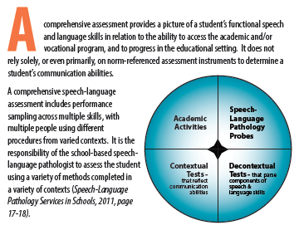
COMPREHENSIVE LANGUAGE EVALUATIONS
A comprehensive assessment may include the following:
norm-referenced tests meeting psychometric criteria for validity and reliability,
criterion-referenced measures,
curriculum-based assessment
developmental scales,
dynamic assessment,
parent, student, teacher interviews/checklists,
observation in the educational environment,
written and oral language samples,
formal assessment in articulation/phonology, and
oral-motor evaluation
Virginia Department of Education website

Slide 87
WV SCHOOLS FEEDING/SWALLOWING PROTOCOL/GUIDANCE
Working with Pam Holland, Professor, Marshall University
Three speech-language pathologists from Monongalia County; Jennifer Poland, Amy Taylor and Nancy Kahl
Draft Protocol on Feeding and Swallowing in the Schools
Guidance in the SLP Guidance Document will remain the same
Planning training in the fall
Providing distance support to SLPS
Presentation and panel discussion at the Lead SLP Meeting on May 11th

Slide 88
DRAFT FEEDING AND SWALLOWING PROTOCOL – Work in Progress

Slide 89
COMMUNICATION MATRIX MODULE PROJECT
Joint effort with the University of Oregon and the WVDE
Nancy Steele, former Project Specialist, National Center on Deaf/Blindness
Annette Carey, contracted, WVDE and WV Birth to Three
Karen Haines, WVU
Lee Ann Brammer, WVDE
Ruth Ann King, WVDE
Consultants
Wendy Garrison, WVDE
Dawn Embrey-King, WVDE
Training module being developed to provide info on administration, interpretation and implementation of the Communication Matrix Module
Hopefully ready for next school year
Will provide free reports statewide for at least a year
ASHA CEUs

Slide 90
QUESTIONS AND CONCERNS

Slide 91
THANK YOU
For your dedication to students
For the time and effort you put into serving your students every single day
For your desire to work at a level of excellence
For having a skill set like no other professional
For giving students the gift of communication

Slide 92
CONTACT INFORMATION
Lee Ann Brammer
lbrammer@k12.wv.us
304.558.2696

